Slide 1

ECEN 361
Real-Time and Embedded Systems
Lecture 3 – Interfaces

Slide 2
Accessing the Processor
We need to get information in/out of our system
Some of that information is Digital – On/off
Some of that information is Analog – A continuous signal
Both of these might come synchronously or asynchronously
Some of that information comes in the form of Standard Communications Busses
UART
I2C/SPI
USB
Bluetooth/WIFI

Slide 3
Inter-Integrated Circuit (I²C)
2-Wire Serial Communication Bus
Introduced By Philips In 1992
Communication Protocol Between Microcontroller And Peripherals
Real Time Clocks (RTCs)
Analog to Digital Converters (ADCs)
Various Sensors
Many, many, more

Slide 4
I²C Characteristics
Only 2 Wires Needed On Bus
Serial Data (SDA)
Serial Clock (SCL)
Multiple Devices Connected On Bus
Typically Limited (i.e. 8, 20, 2⁷, 2¹⁰,...?)
Similar Code For All I²C Peripherals
Supports Various Data Transfer Rates

Slide 5
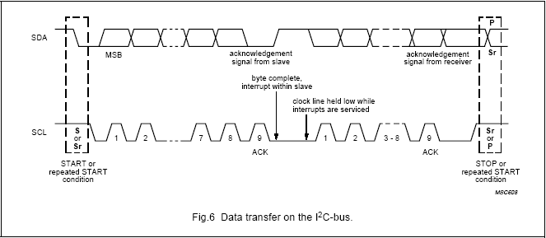
How Does It Work?

Slide 6
Serial Peripheral Interface (SPI)
Synchronous Communication Protocol
3-Wire (Plus 1 Chip-Select Pin/Device)
Hardware On Microcontroller
Developed By Motorola
“Loose” Standard
Broad Range of Devices Supported
Memory (i.e. EEPROM, RAM, Etc.)
Sensors

Slide 7
SPI Characteristics
3 Wires (Plus Chip Select Pin/Device)
Master Out Slave In (MOSI)
Master In Slave Out (MISO)
Master/Slave Clock Output/Input (SCK)
Chip/Slave Select (SS)
Multiple Devices Connected On Bus
Limited Only By Number Of uC Pins
Supports Various Data Transfer Rates

Slide 8
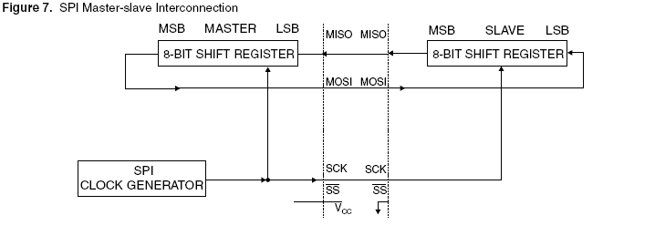
How Does It Work?

Slide 9
SPI Summary
3-Wire (+ SS/Device)
1.5 MHz Bit Frequency (AT89S53)
Microcontroller Hardware
Supports Many Devices

Slide 10
Wireless Communications
Simple Point-to-Point communications
Bluetooth
WIFI
Xbee – Other mesh networks

Slide 11
Simple RF
A Point-to-Point communication Technology
Normally works in an unlicensed band
Connects to the UART – The device sees a UART terminal
Requires some sort of configuration

Slide 12
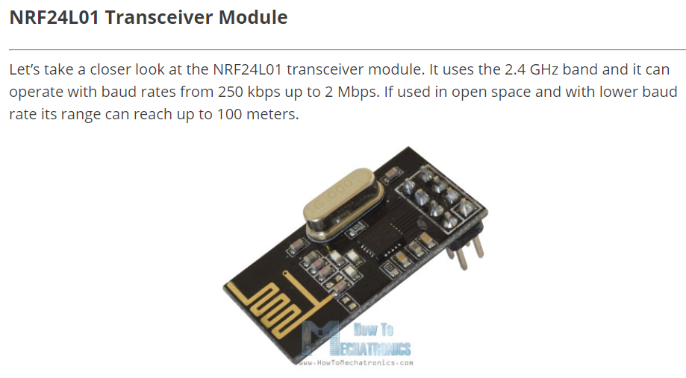
Simple RF

Slide 13
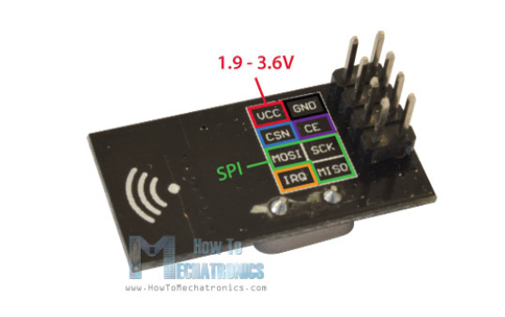
Simple RF

Slide 14
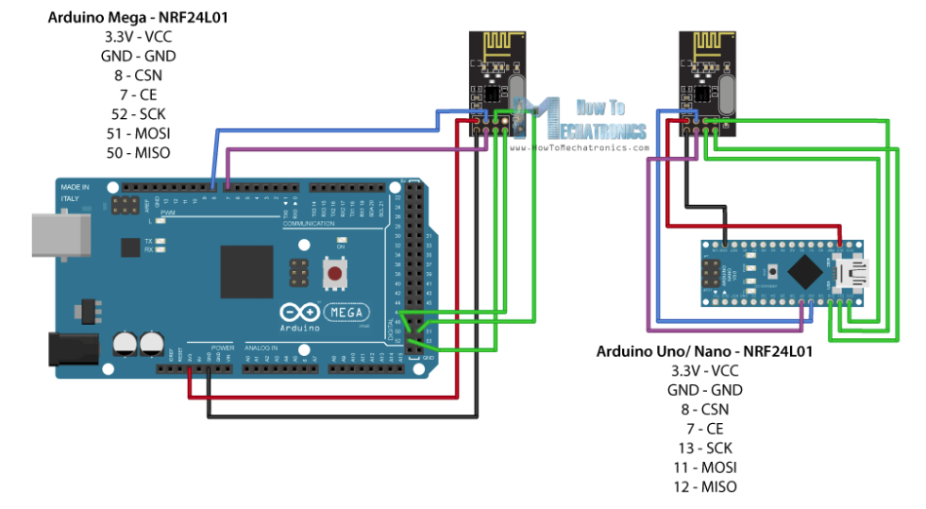
Simple RF

Slide 15
Bluetooth
Short range communication in the 2.4 GHz band
Initially designed as a cable replacement technology – Connecting keyboards, mice, speakers.
Set up mostly in a single master, many slave configuration.

Slide 16
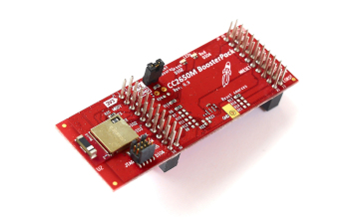
Bluetooth

Slide 17
WIFI - What is IEEE 802.11?
Standard for wireless local area networks (wireless LANs) developed in 1990 by IEEE
Intended for home or office use (primarily indoor)
802.11 standard describes the MAC layer, while other substandards (802.11a, 802.11b) describe the physical layer
Wireless version of the Ethernet (802.3) standard

Slide 18
Wifi
Short range communication in the 2.4/5.8 GHz band
Designed to replace LAN cables
Set up in mostly a peer network – however one of the devices has to provide the IP addresses (DHCP). This is the access point.

Slide 19
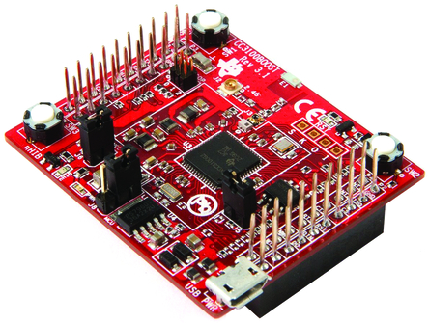
Wifi

Slide 20
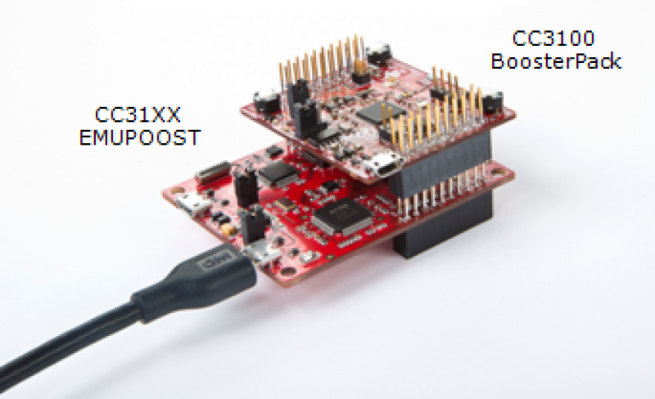
Wifi

Slide 21
Wifi
Range of Wifi
Standard Range – 30 meters
Range with Antenna
Several hundreds of meters

Slide 22
What is Zigbee?
Based on IEEE 802.15.4 Standard
Designed for sensor and control networks
Used for applications that require:
Low Power Consumption
Low Data Rate
Network Security

Slide 23
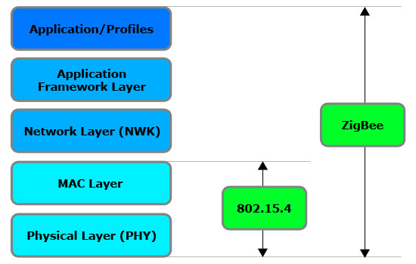
Zigbee Layers

Slide 24
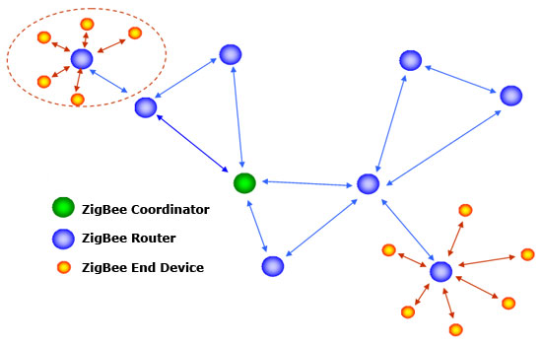
A Zigbee Network

Slide 25
Xbee Wireless Modules
Features/Benefits
www.digi.com
802.15.4/Multipoint network topologies
2.4 GHz for worldwide deployment
900 MHz for long-range deployment
Low-power sleep modes
Multiple antenna options
Low power and long range variants available

Slide 26
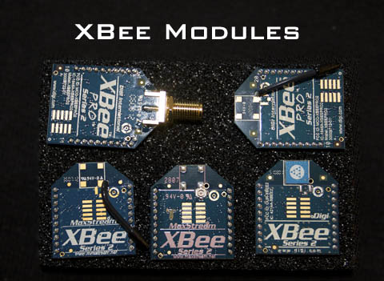
Xbee Wireless Modules

Slide 27
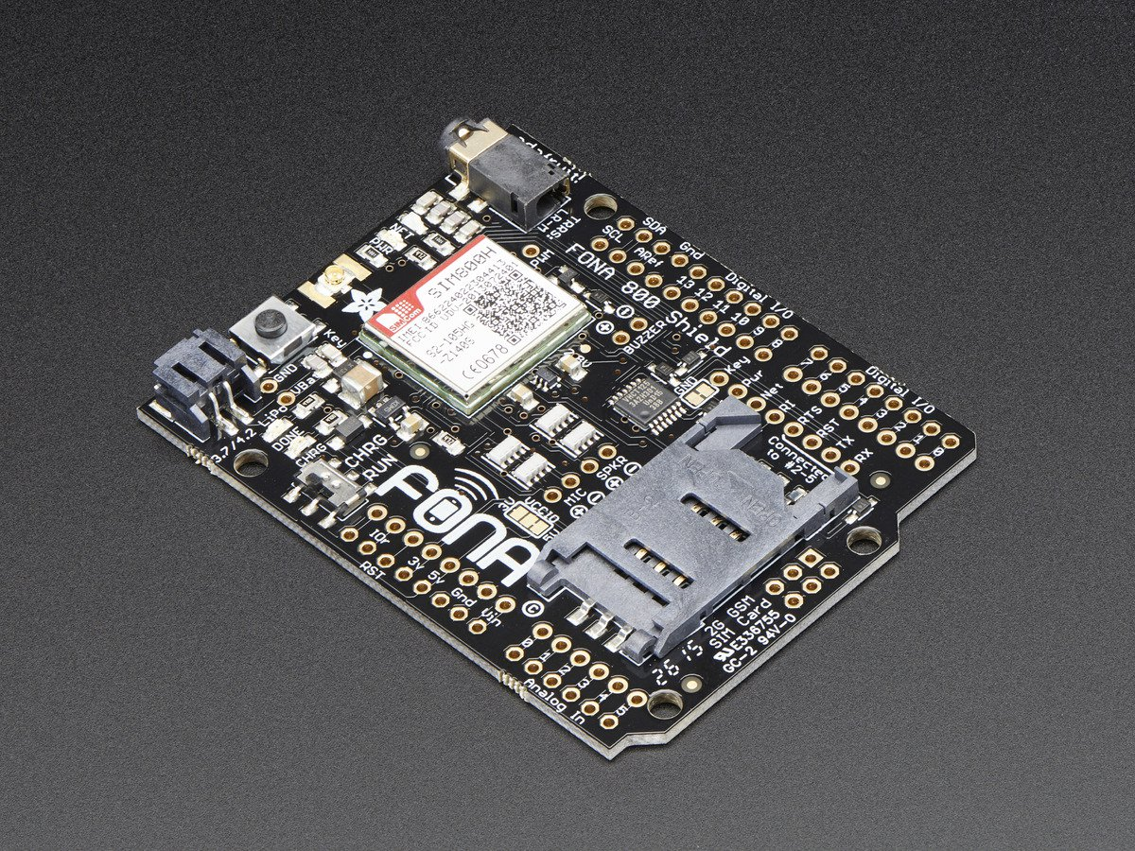
Cellular Connection

Slide 28
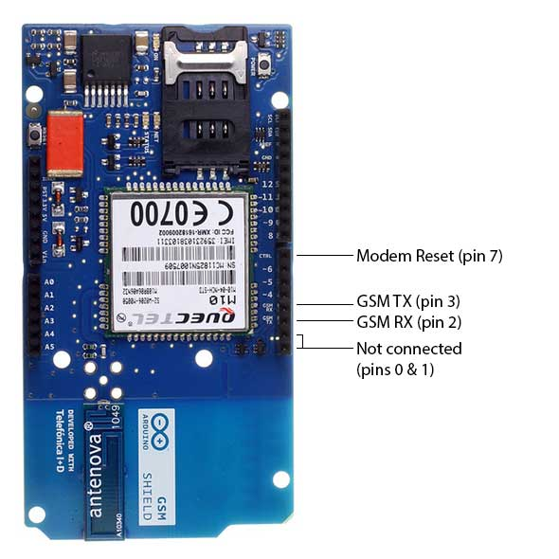
Cellular Connection
The Arduino GSM Shield connects our Arduino to the network. Plug in a SIM card from an operator offering GPRS coverage and also you can also make/receive voice calls and send/receive SMS messages.
Quad-band GSM/GPRS modem that works at frequencies GSM850MHz, GSM900MHz, DCS1800MHz andPCS1900MHz

Slide 29
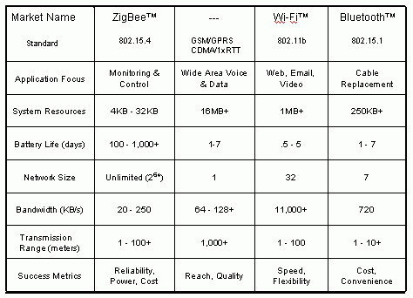
The Various Protocols

